Slide 1





SOLDERING WORKSHOP
Athena Galbraith
SCHOOL HOLIDAY PROGRAM SUMMER 2024
Notes:
- Who am I?
- Why am I working at BINAR?

Slide 2
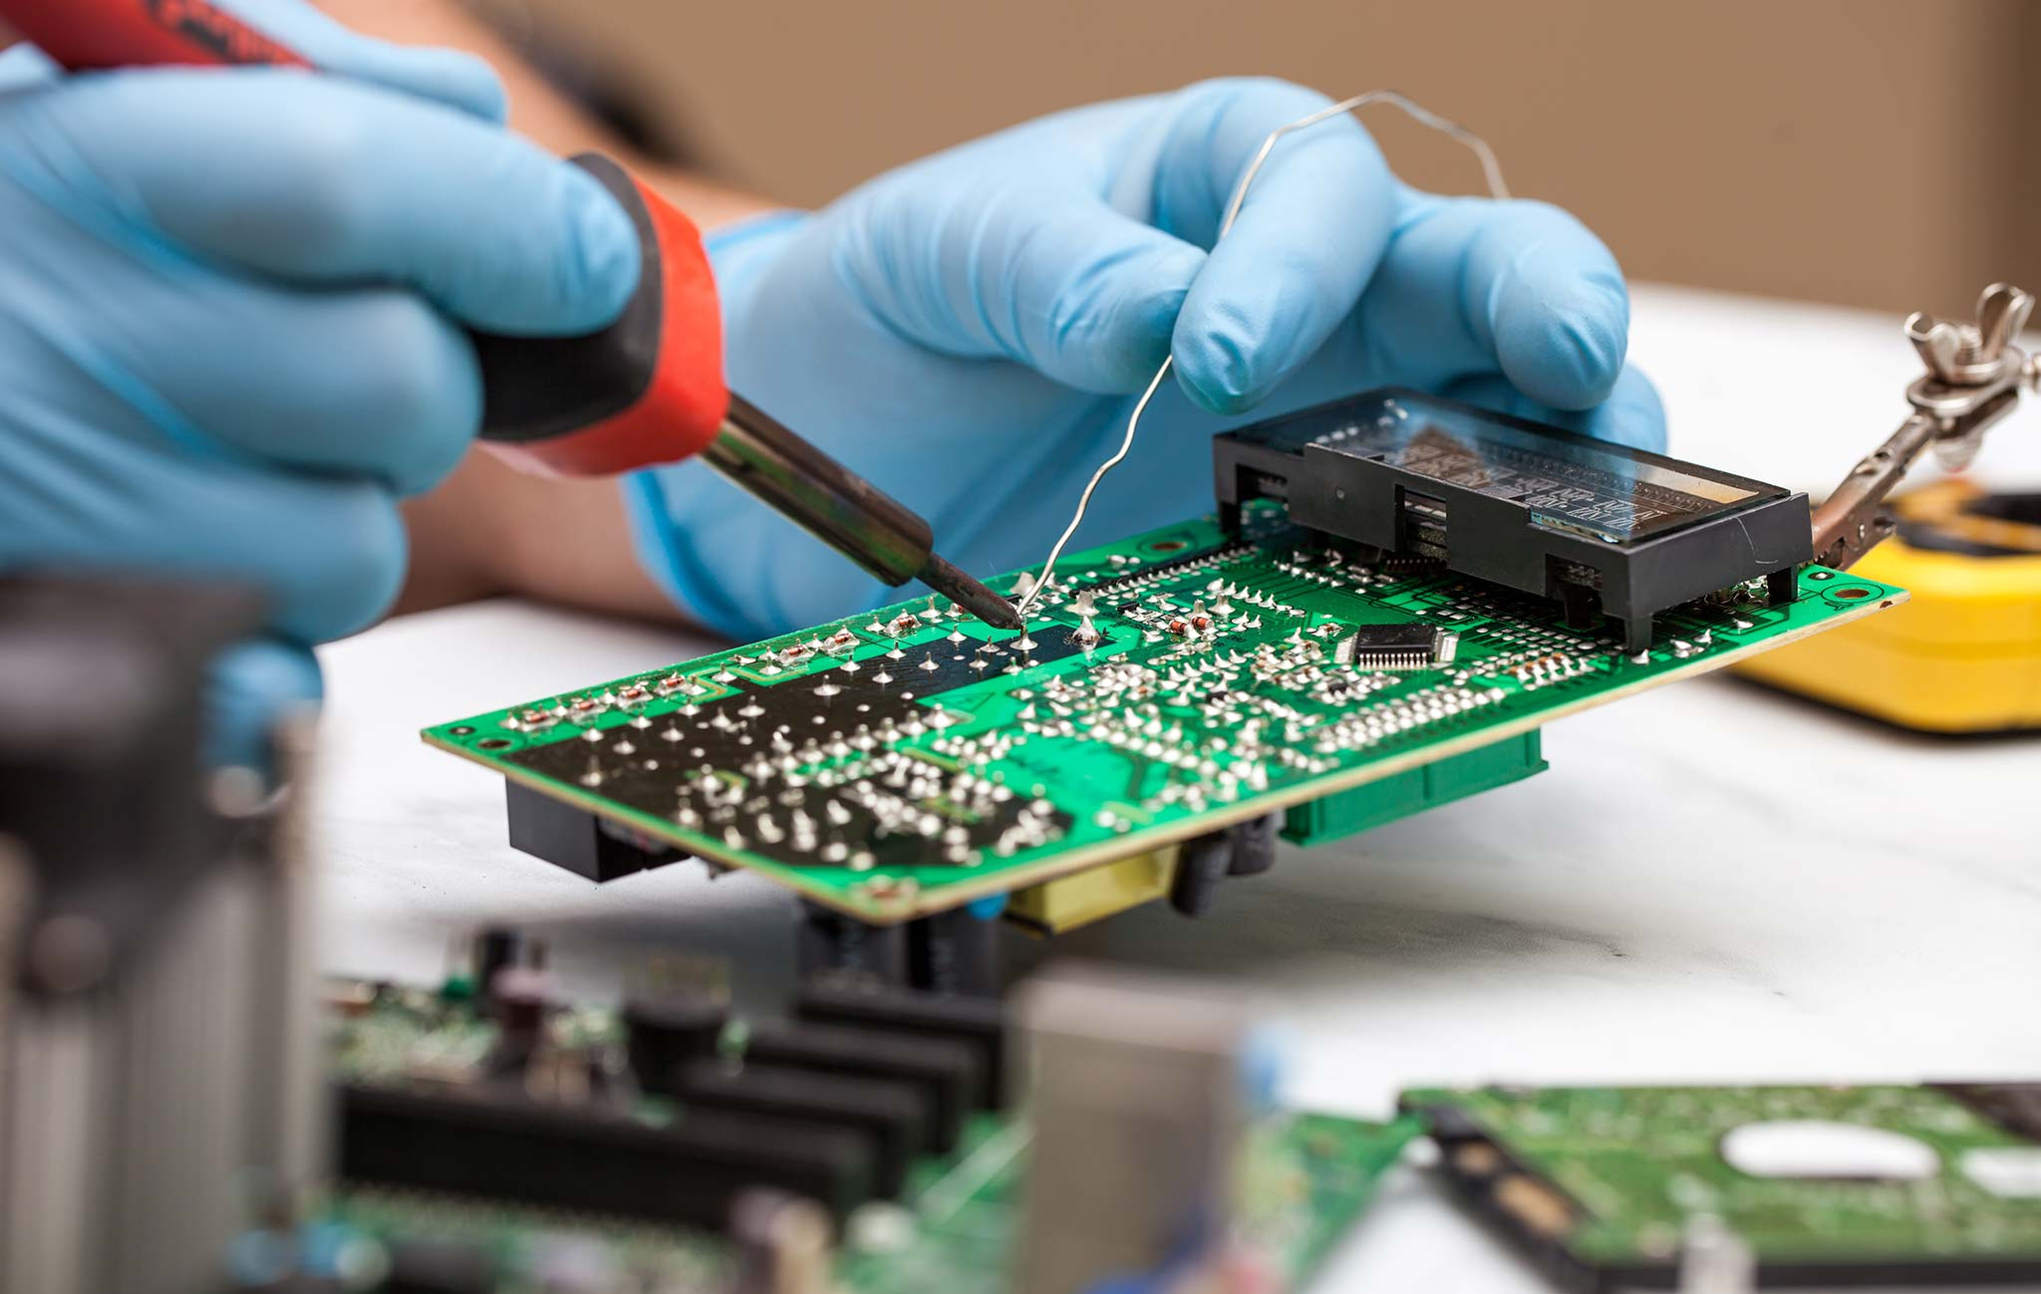
What is soldering?
Soldering is the process of using Solder to fix components to a PCB or other electrical board.
The form you will be doing is through hole soldering, where components sit in the hole and you fill the gap with solder, bonding the 2 components.
Other forms include using paste, soldering onto the top of gold pads or using vats of liquid solder
https://www.twi-global.com/technical-knowledge/faqs/what-is-soldering
Notes:
- Soldering is when you get 2 bits of metal and join them by melting more metal together

Slide 3
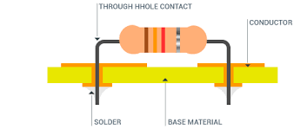
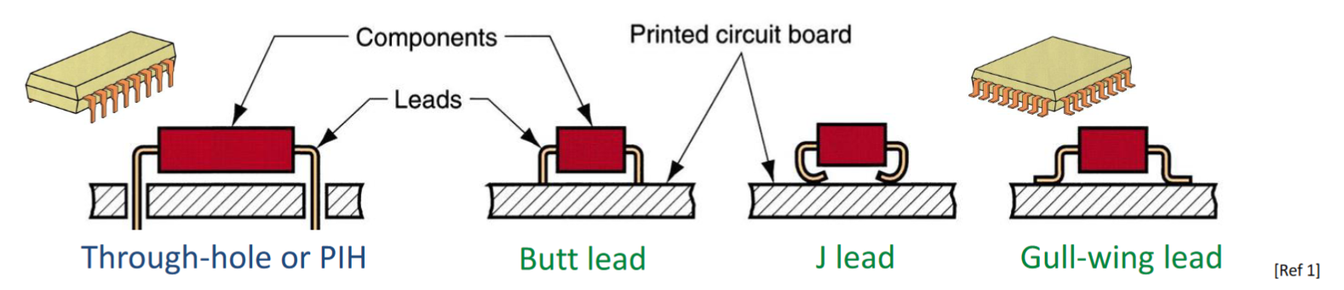
What you’ll be doing
Through hole soldering is where a PCB board already has drilled and coated holes where components are designed to slot in.
Components are slotted in, and then to ensure electrical and physical connection, the component leads, and the PCB pad are heated and then solder is melted between the two.
https://www.pcbdirectory.com/community/what-are-plated-through-holes

Slide 4

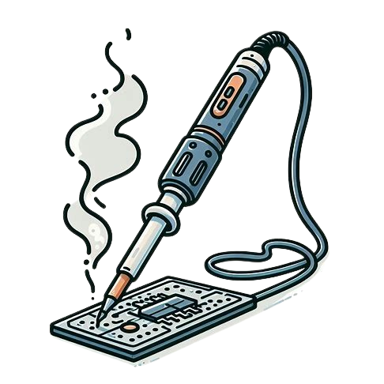
Preparing to Solder
Check environment for hazards (Trip, Water, Electrical)
Safety Glasses
Install the soldering tip you need.
Turn ON soldering Iron and set temperature.
Check Work Piece
Turn on Exhaust Fan
Touch tip of Soldering Iron to the material to be soldered, then apply the solder to the heated area. Once solder runs and forms around material, remove iron.
Allow joint to cool.
Continue Soldering
After you are done, Tin iron with solder, return to the stand and turn off power.
Notes:
This is important, make sure all the kids are listening
- Promise to bribe them?

Slide 5
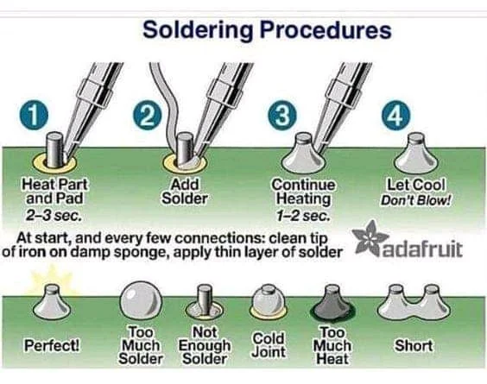
HOW to Solder
Make sure component is lined square with the PCB board.
Apply solder tip to the metal pad (Gold) and the part, until both are hot.
Apply solder to the pad and part and keep applying until a good connection is formed. (A cone like shape that covers the whole of the pad)
You will probably not need as much solder as you think you do.
Remove soldering iron and move to next part
https://www.raypcb.com/through-hole-soldering/

Slide 6
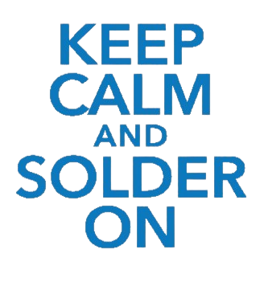
Tips and tricks
Don’t Panic. The majority of mistakes are easily fixed, and us fixing the mistake is much preferred than you panicking.
You are holding a metal rod that is over 350 Degrees, always keep your fingers on the insulated part and be wary of where you are pointing the soldering iron. Students not paying attention to where their iron is pointing may lose soldering privileges.
This tool can burn you instantly. If you do get burned, place the soldering Iron back in its holder and tell a BINAR member.
Don’t try to melt the solder with the soldering iron, the pads should be hot enough to do this without direct contact with the iron. Trying to melt with the iron will lead to frustration and sadness.
The pads can absorb heat very well, this means that the pads can burn you after the soldering iron has been removed, be careful!
The PCB cannot handle heat well, try to avoid touching it with the soldering iron else it will melt and smoke.

Slide 7
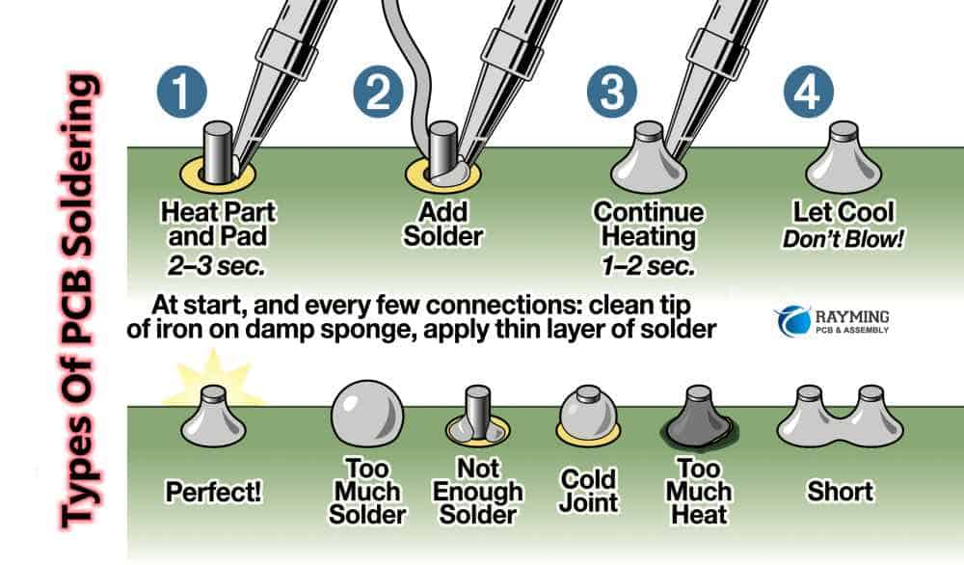
Let's get to it
Remember : The iron will burn you in under a second if you aren’t careful!

